Slide 1

School of Computer Science and Engineering Department of Computer Science and Engineering
A Comparative Study of Machine Learning and Deep Learning Models on the Pediatric Intensive Care (PIC) Database
Submitted By: Divyanshu Patel
2427030037
Supervised By: Dr. Akshay Jadhav

Slide 2

Outline
Introduction
Literature Review
Problem Statement
Proposed Solution
Objectives

Slide 3
Introduction
Background:
Pediatric Intensive Care Units (PICU) generate large volumes of clinical data.
Accurate prediction of outcomes (ICU mortality, In-hospital mortality, length of stay, etc) is crucial for improving patient care and early intervention in high risk cases.
Traditional risk scores are limited; machine learning (ML) and deep learning (DL) can leverage complex patterns in tabular data.

Slide 4
Introduction
Motivation:
Improving and personalizing patient healthcare using ML and DL applications.
Need for automated, data-driven decision support systems which can be used to evaluate the risk levels of the patient and hence help in early intervention.
Opportunity to benchmark ML vs DL approaches to identify optimal predictive strategies.

Slide 5
Literature Review
Existing Work:
Major patterns across the literature:
Several pediatric ICU studies (PROMPT, Criticality Index, RF 72-h model) demonstrate strong predictive performance using sequence-aware DL or well-engineered ML ensembles, depending on the task and data representation.
Benchmarking research on tabular data shows gradient boosting trees (GBDTs) commonly match or beat DL unless specific sequence/temporal representations or very large sample sizes are used.
Many pediatric studies report good discrimination but limited external validation, inconsistent calibration assessment, and little standardized head-to-head benchmarking (i.e., DL vs GBDT with equal tuning).

Slide 6
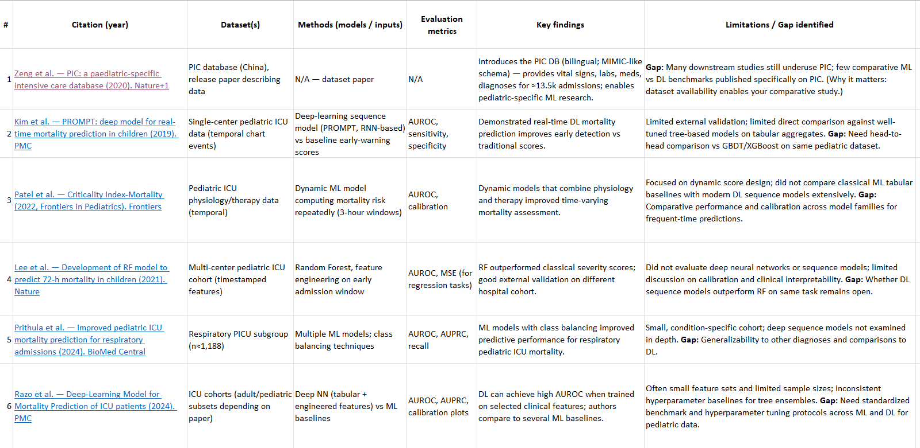
Comparative Summary of Existing Literature

Slide 7
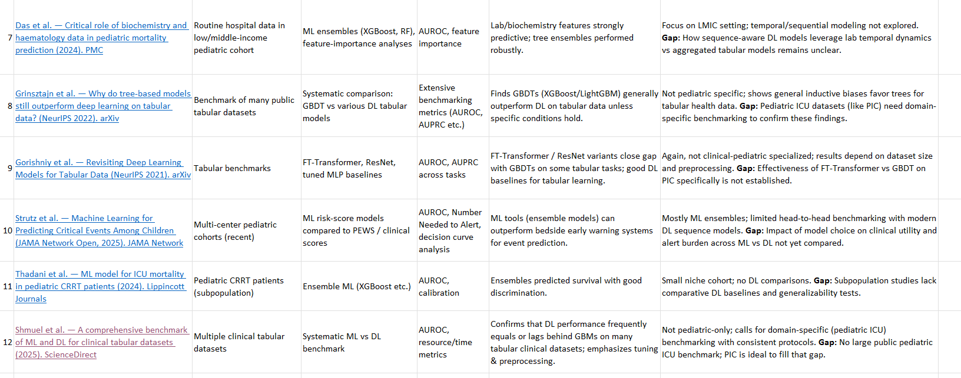
Comparative Summary of Existing Literature

Slide 8
Literature Review
Gaps Identified:
Direct, standardized head-to-head comparison of ML vs DL on the PIC database, using identical preprocessing, hyperparameter search, and evaluation).
Calibration and clinical-utility evaluation
Temporal vs aggregated representations: quantify how much sequential DL gains when given raw time-stamped chart events vs aggregated per-stay features used by tree models. Prior works used one or the other without systematic comparison.
External validation and subgroup fairness (age groups, diagnosis categories) for pediatric models — many papers report internal performance only.

Slide 9
Literature Review
Summary:
Most pediatric ICU studies use either deep sequence models or tree-based ML models, but none compare them fairly on the same PIC dataset. Prior work also rarely evaluates calibration, clinical utility, or subgroup performance. Our study fills this gap by conducting a rigorous, standardized ML vs DL benchmark on the PIC database using identical preprocessing and evaluation protocols.

Slide 10
Problem Statement
A Comparative Study of Machine Learning and Deep Learning Models on the Pediatric Intensive Care (PIC) Database

Slide 11
Objectives
Early detection:
When a patient is admitted model runs on the data and evaluates a risk score that can then be used to provide more monitoring and faster intervention in high risk cases.
Resource Allocation:
Hospitals have limited beds and staff so we can priortize critical patients and allocate resources efficiently.
Continuous Monitoring:
Model can run repeatedly on the patient data and predict real time risk scores that can be helpful in detecting deterioration early.

Slide 12
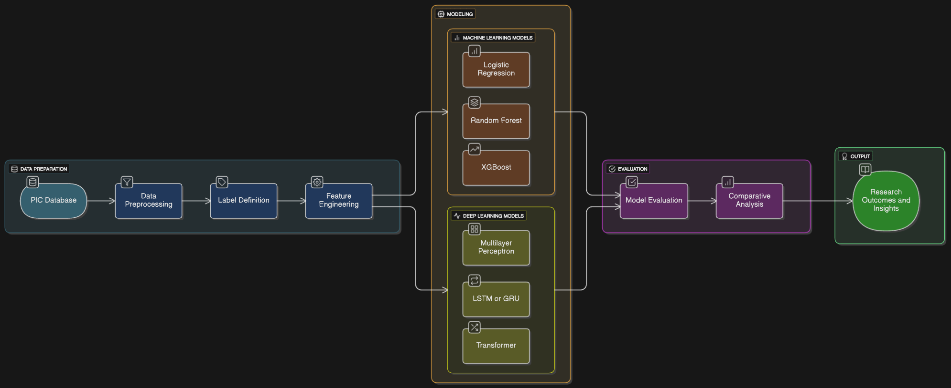
Block Diagram

Slide 13
Proposed Solution
Approach / Steps:
Data Preprocessing:
Clean, merge 16 PIC tables, handle missing values.
Label Definition:
Define outcomes: mortality, LOS, ventilation, readmission, organ support, sepsis.
Feature Engineering:
Static features (demographics, comorbidities), temporal features (vitals, labs).
Model Training:
Classical ML: Logistic Regression, Random Forest, XGBoost.
DL: MLP, LSTM/GRU, Transformer-based models.
Evaluation: AUROC, AUPRC, F1, MAE/RMSE, calibration, SHAP analysis.
Comparative Analysis & Visualization: Performance vs interpretability trade-offs.

Slide 14
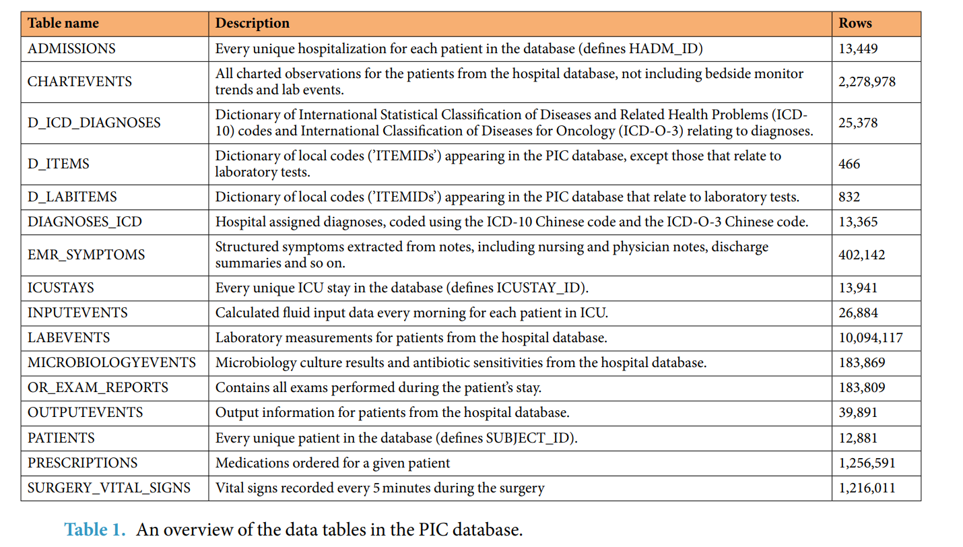
Progress
Original:
In the original dataset sourced from PhysioNet there were 16 different .csv sheets and after several preprocessing steps like data cleaning, feature engineering, language conversion from Chinese to English using a translation model from Hugging face, etc we have a combined dataset that will now be separated into ML and DL specific dataset.

Slide 15
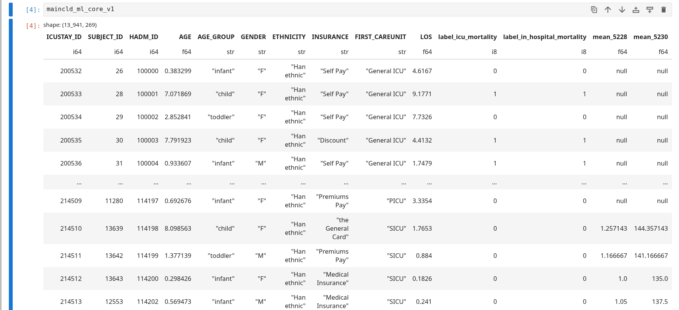
Progress
Dataset v1 snapshot:

Slide 16
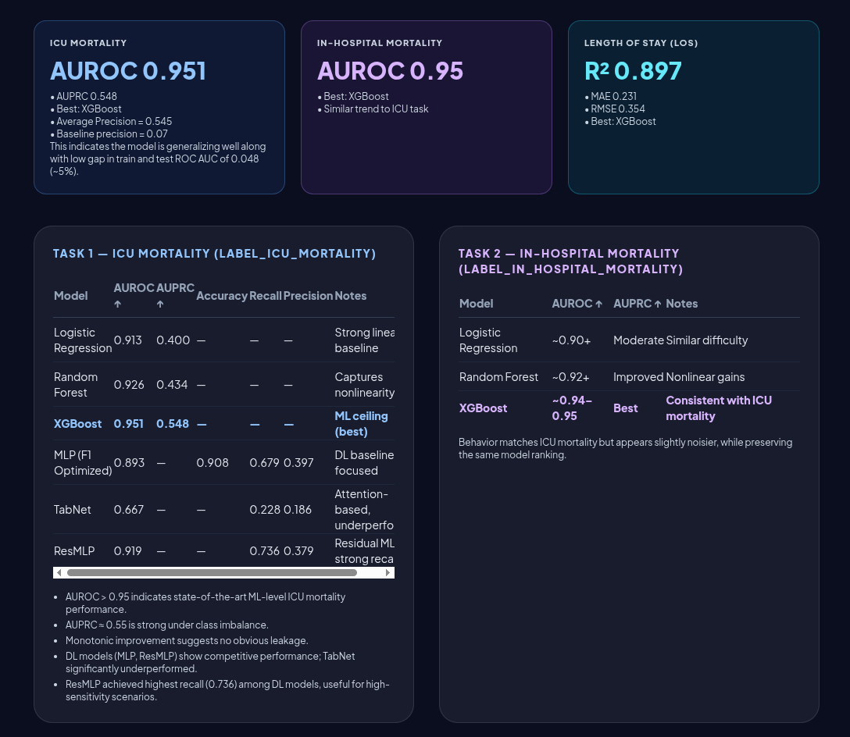
Results

Slide 17
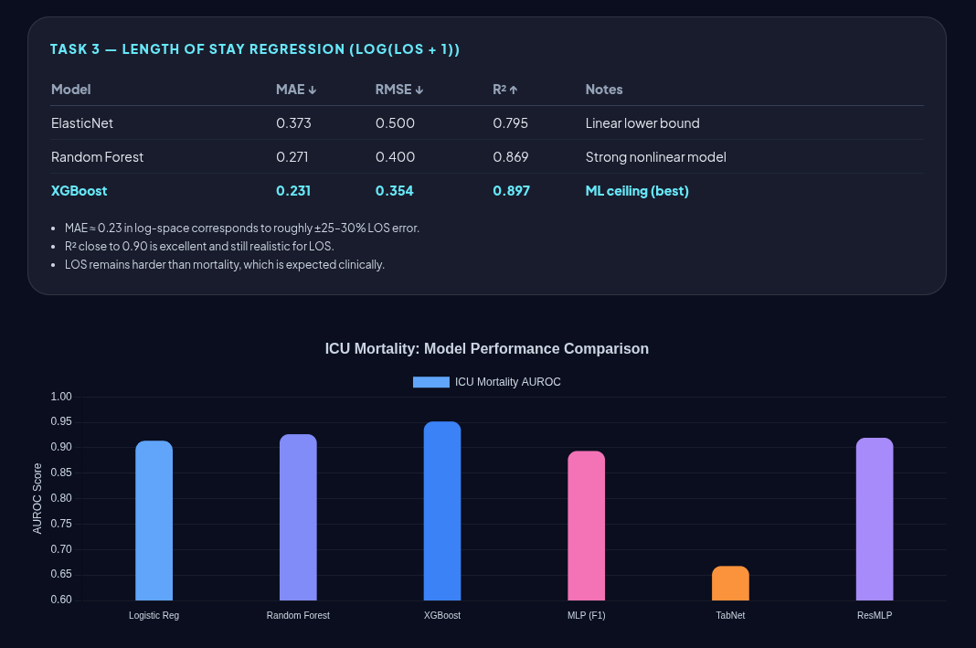
Results

Slide 18
References
Zeng, X., Yu, G., Lu, Y. et al. PIC, a paediatric-specific intensive care database. Sci Data 7, 14 (2020). https://doi.org/10.1038/s41597-020-0355-4
Kim SY, Kim S, Cho J, Kim YS, Sol IS, Sung Y, Cho I, Park M, Jang H, Kim YH, Kim KW, Sohn MH. A deep learning model for real-time mortality prediction in critically ill children. Crit Care. 2019 Aug 14;23(1):279. doi: 10.1186/s13054-019-2561-z. PMID: 31412949; PMCID: PMC6694497.
Patel AK, Trujillo-Rivera E, Morizono H and Pollack MM (2022) The criticality Indexmortality: A dynamic machine learning prediction algorithm for mortality prediction in children cared for in an ICU. Front. Pediatr. 10:1023539. doi: 10.3389/fped.2022.1023539
Lee, B., Kim, K., Hwang, H. et al. Development of a machine learning model for predicting pediatric mortality in the early stages of intensive care unit admission. Sci Rep 11, 1263 (2021). https://doi.org/10.1038/s41598-020-80474-z
Prithula, J., Chowdhury, M.E.H., Khan, M.S. et al. Improved pediatric ICU mortality prediction for respiratory diseases: machine learning and data subdivision insights. Respir Res 25, 216 (2024). https://doi.org/10.1186/s12931-024-02753-x
Razo M, Pishgar M, Galanter W, Darabi H. Deep-Learning Model for Mortality Prediction of ICU Patients with Paralytic Ileus. Bioengineering (Basel). 2024 Nov 30;11(12):1214. doi: 10.3390/bioengineering11121214. PMID: 39768031; PMCID: PMC11673219.
Das S, Erdman L, Brals D, Boczek B, Hasan SMT, Massara P, Alam MA, Fahim SM, Mahfuz M, Hoogendoorn M, Zuiderent-Jerak T, Bandsma RHJ, Ahmed T, Voskuijl W. Development of machine learning models predicting mortality using routinely collected observational health data from 0-59 months old children admitted to an intensive care unit in Bangladesh: critical role of biochemistry and haematology data. BMJ Paediatr Open. 2024 Jul 22;8(1):e002365. doi: 10.1136/bmjpo-2023-002365. PMID: 39038911; PMCID: PMC11409392.
Grinsztajn et al. — Why do tree-based models still outperform deep learning on tabular data? (NeurIPS 2022). arXiv

Slide 19
References
Gorishniy et al. — Revisiting Deep Learning Models for Tabular Data (NeurIPS 2021). arXiv
Strutz S, Liang H, Carey K, et al. Machine Learning for Predicting Critical Events Among Hospitalized Children. JAMA Netw Open. 2025;8(5):e2513149. doi:10.1001/jamanetworkopen.2025.13149
Thadani, Sameer MD1; Wu, Tzu-Chun PhD2; Wu, Danny T. Y. PhD2,3; Kakajiwala, Aadil MD4; Soranno, Danielle E. MD5; Cortina, Gerard MD6; Srivastava, Rachana MD7; Gist, Katja M. DO3; Menon, Shina MD8; on behalf of the Worldwide Exploration of Renal Replacement Outcomes Collaborative in Kidney Diseases (WE-ROCK) Collaborators. Machine Learning-Based Prediction Model for ICU Mortality After Continuous Renal Replacement Therapy Initiation in Children. Critical Care Explorations 6(12):p e1188, December 2024. | DOI: 10.1097/CCE.0000000000001188
Assaf Shmuel, Oren Glickman, Teddy Lazebnik,
A comprehensive benchmark of machine and deep learning models on structured data for regression and classification,
Neurocomputing,
Volume 655,
2025,
131337,
ISSN 0925-2312,
https://doi.org/10.1016/j.neucom.2025.131337.
(https://www.sciencedirect.com/science/article/pii/S0925231225020090)

Slide 20
Thank you

